Slide 1



YOUNG WATER ANDERSON
TEAM 2
ST CITY HOTEL
AUDIT REPORT
The Hotel is principally operating a 4-star city hotel in the heart of Kuala Lumpur city.

Slide 2
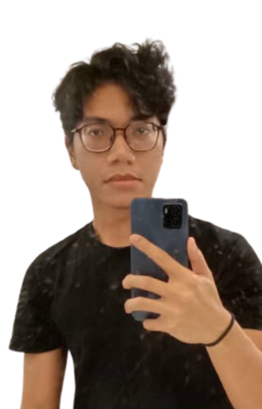
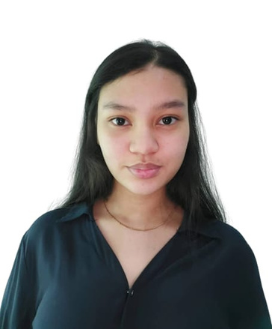
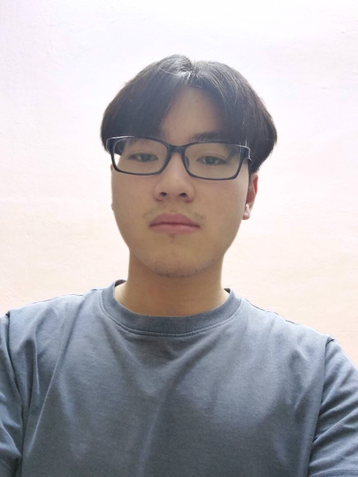

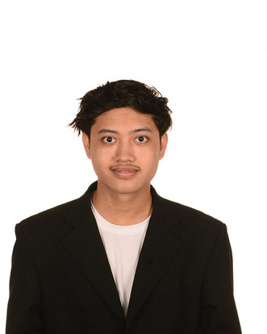
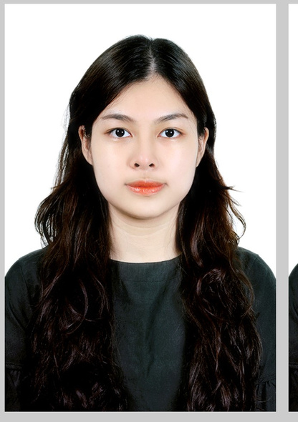
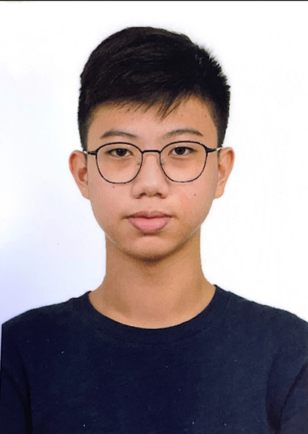
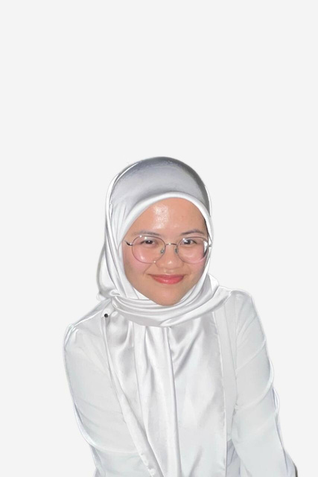
Our Team
YOUNG WATER ANDERSON
Danial Hariz
Yasmin Zuraisyah
Ming Yu
Arif Shamim
Leader
Assistant Leader
Team Member
Team Member
Arman Aqeel
Pham Anh Thu
Yong Sheng
Nur Balqis
Team Member
Team Member
Team Member
Team Member

Slide 3

COMPANY PROFILE
YOUNG WATER ANDERSON
Company's Philosophy
This company is incorporated on 2 April 2012 by Tan family, they are ambitious to bring ST City Hotel brand into Malaysia.
Actions
Internal stakeholders
Business operations
Undergone several mergers and acquisitions
Lyn Tan
10%
About 74% of the Hotel’s revenue are generated from the hotel rooms, 23% from banquet, conference, balance of 3% from rental and other income.
Kenneth Tan
10%
Tan Kai Wan
20%
ST Holdings Sdn. Bhd
60%

Slide 4





AUDIT RISKS
YOUNG WATER ANDERSON
Revenue and Key customers
Involvement in E-commerce
Industry regulations of hotels
Accept customers even have a bad record in credit terms
Reliance on third party systems
Transfer between system
Research and Development Activities
Key Suppliers
Periodic price check
Mgmt may under pressure to reduce price
Invest in research and development activities during the year
Classification error

Slide 5


AUDIT RISKS
Adoption of Information Technology
Financing Activities
Obtains loans, and finance lease for major capital
Expenditures
The effectiveness of new system
The substantial investment in

Slide 6
YOUNG WATER ANDERSON
INTERNAL CONTROL DEFICIENCIES
-Lack of segregation of duties
-Revenue Director responsible for both approval and publication of room prices
-Result in inappropriate prices being set
-Recommend to segregate the duties to different individuals
Sales
-Management did not check the current inventory level in the warehouse when making purchase requisitions
-Difficult to process the obsolete and damaged inventory timely
-Recommend to match the purchase requisition to the inventory level
Purchases
-Accountant approved the payment vouchers prepared by accounts executive
-Accountant not senior enough and may result in payment being misstated
-Recommend that the Finance Director undertakes the approval
Payment

Slide 7

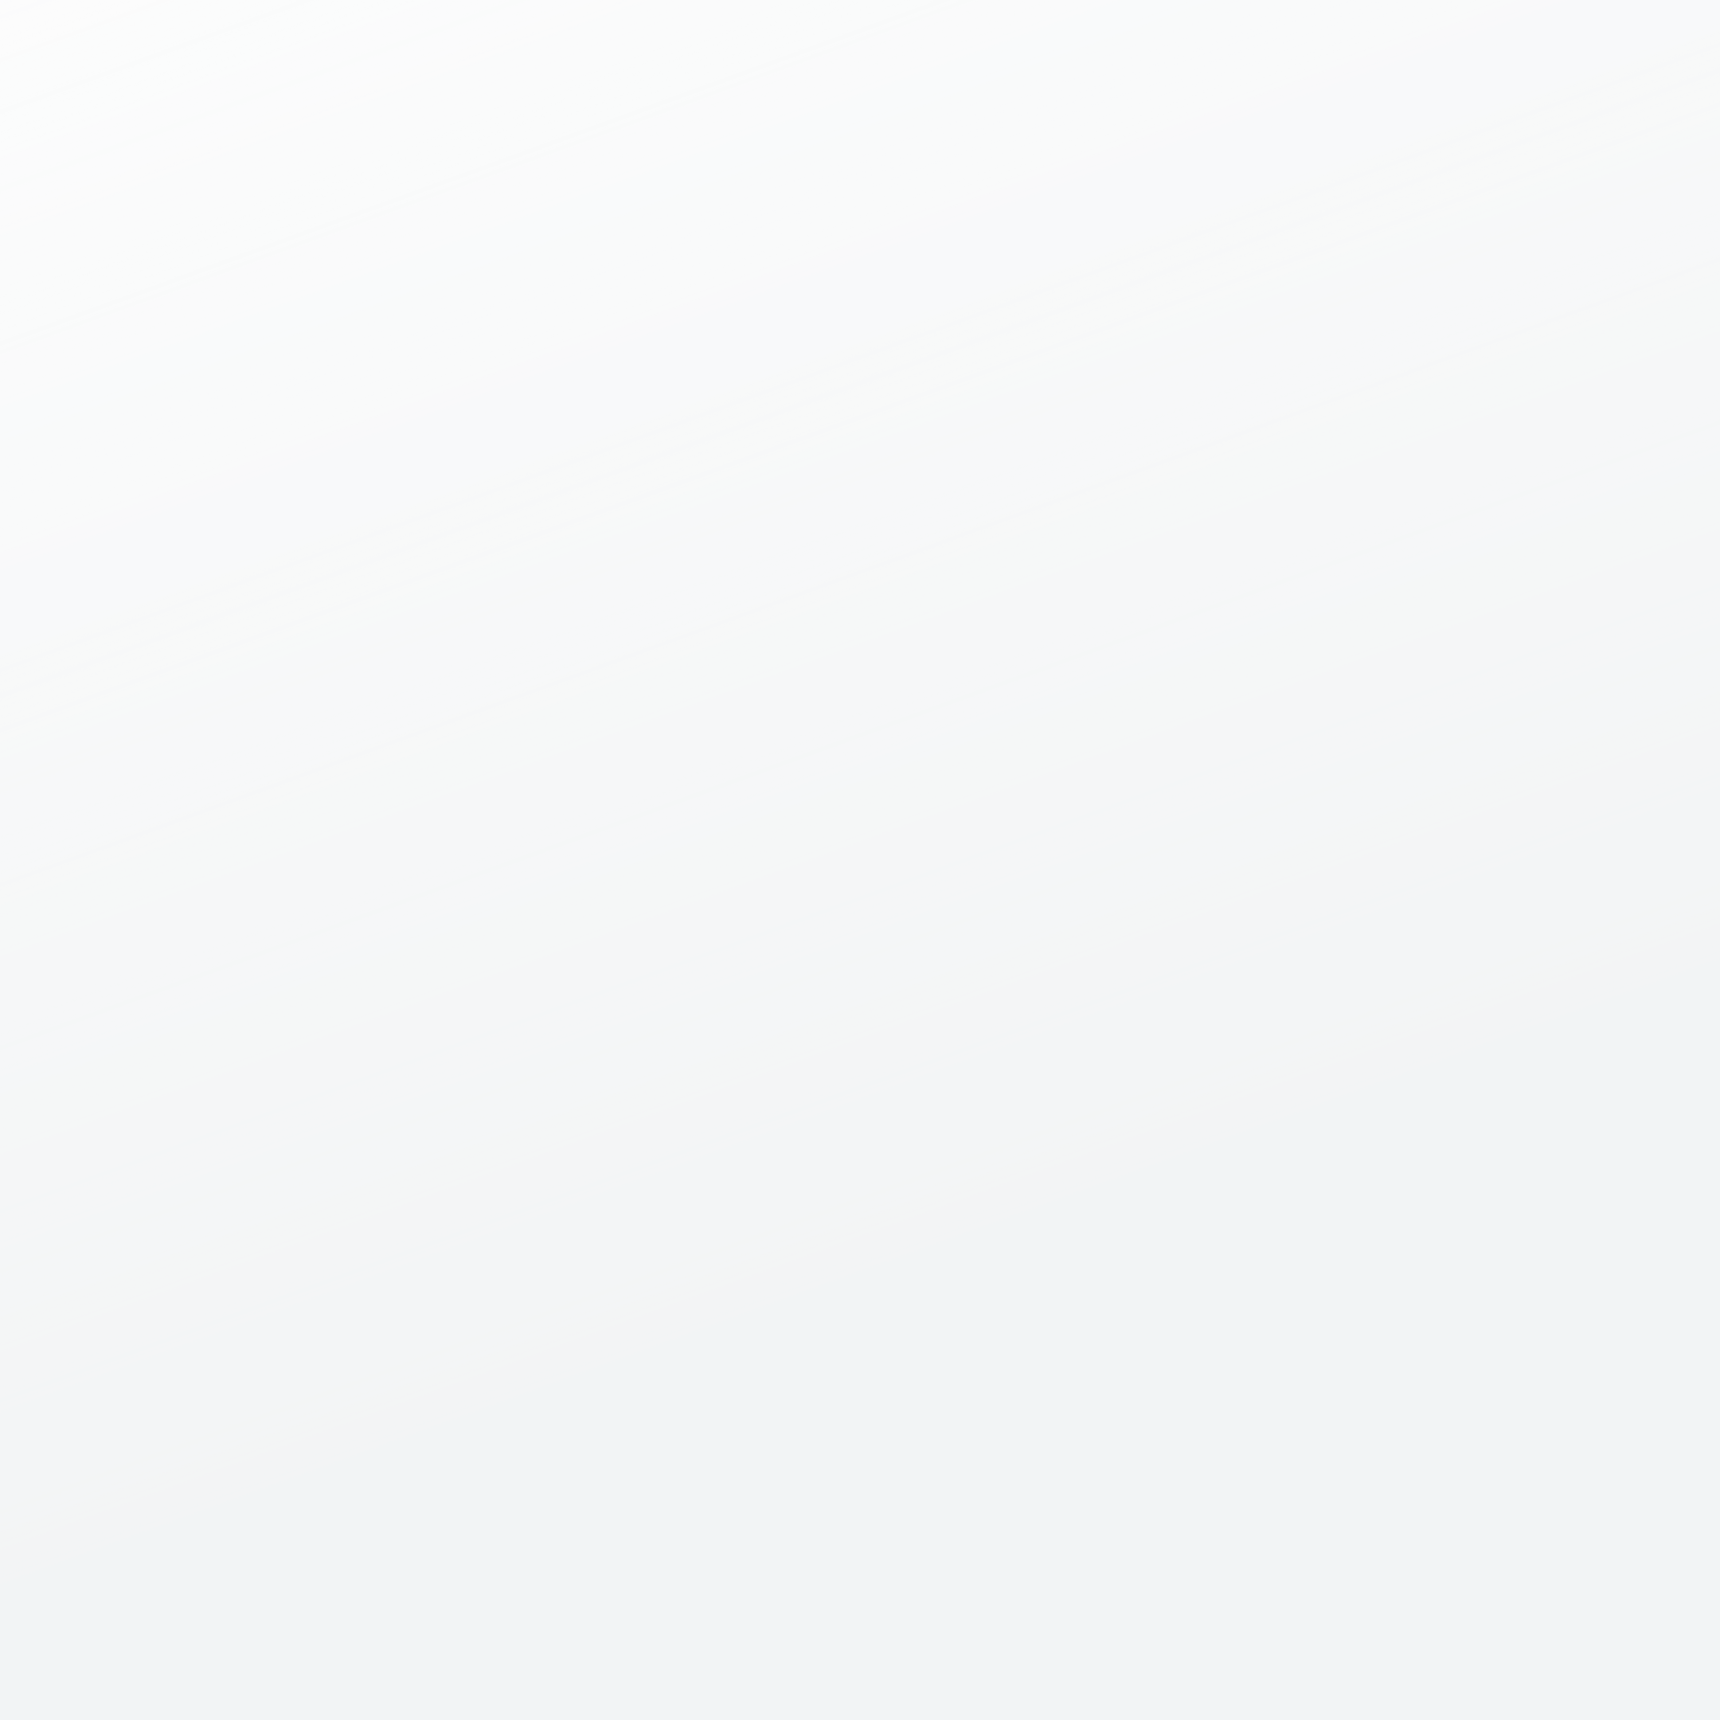

SUMMARY OF MATTERS TO BE BROUGHT TO THE ATTENTION OF THE ENGAGEMENT PARTNER
YOUNG WATER ANDERSON
Receivables
Room Revenue
Cut-off issue due to recognition of sales made after year-end.
Causing overstatement of revenue by RM7,006.69
Banquet & Event Sales
Cut-off issue due to recognition of sales made after year-end.
Causing overstatement of revenue by RM68,490.84
Rental Revenue
Incorrect recognition of deposit of RM 6,000.00

Slide 8


SUMMARY OF MATTERS TO BE BROUGHT TO THE ATTENTION OF THE ENGAGEMENT PARTNER
YOUNG WATER ANDERSON
Salaries and Payroll
Purchase
EPF misstatement causing understatement of payroll expense and profit be overstated
by RM10170
Items misincluded in invoice causing
overstatement of purchase by RM5206
and payment recorded in wrong supplier account causing payables of Bio Hygiene Sdn Bhd overstated by RM6648.90
01
02

Slide 9

MATERIALITY
YOUNG WATER ANDERSON
Total uncorrected misstatements of RM115,255.71 is below our overall materiality.
5.24%
Misstatement of EPF
Unrecognized impairment losses
Cut-off error
Percentage of Uncorrected Misstatements
to FS Amounts (%)

Slide 10


YOUNG WATER ANDERSON
REPORT ON THE AUDIT OF THE FINANCIAL STATEMENTS
Opinion
The Financial Statement as at 31 December 2022 gives a true and fair view.
Basis for Opinion
We believe that the audit evidence obtained is sufficient and appropriate to provide a basis for our opinion.

